Slide 1



Presenters:
DG Dick Silveira and
Barbara Toosley, PDG
2012
“Keep‘em from Leavin”
Please turn your CELL PHONES OFF
All Tail Twister Fines will go to LCIF

Slide 2
PROGRAM
What History Tells Us
Some Ideas to help keep‘em
The Pieces of the Puzzle
Where you Fit In and How You Can Help

Slide 3

FIRST
To understand how we
“Keep’em”,
we must understand how we
“Lose’em”

Slide 4
Team Exercise
You have 1 minute to identify the number one reason….
Why
They
Leave
Why
They
Stay

Slide 5
WHY LIONS LEAVE
Lack of leadership
Expectations are not met
Same old projects with the same people
Lack of meaningful engagement
Induction ceremony is poorly conducted
No orientation program
The “Play Ground Bully”

Slide 6
WHY LIONS STAY
Friendship
Fun
Knowing that people depend on Lions
Feeling of accomplishment

Slide 7
We do have a few
THOUGHTS on what we might do to “Keep’em.”

Slide 8

How
        Can
WE
Keep Our
Members
It’s a puzzle, which piece it right for
your club?

Slide 9

Are your Lions a little frayed around the edges?

Slide 10
Do they need to be rejuvenated?

Slide 11

What Does our Race Car Look Like
Is it bright and shinny
  ready for new members
Is it broken down and members are just waiting to jump off at the next pit stop

Slide 12
A serious Organization that needs to have FUN
F inding a way to laugh and work
U nderstanding the Tail Twister
N ever saying Never

Slide 13
Fun Ideas
Crazy Hat or Shirt Night
Mystery Gift
Funny or unique Award
Club Social
Tail Twister
Your Ideas?

Slide 14
We can only offer our
Members is the
Hope, Care and Love
that we give to those we serve.

Slide 15
Evolution of Lions Needs
1 – 5 Years: Nurture, Develop, Orientate
6 – 15 Years: Leadership Development
16 +: Mentoring, Respected
All Lions: To feel Valued and Proud

Slide 16
How do we know?
Send a survey to new members after they have
been a member for 6 months. Ask them:
What do you feel about being a Lion?
Have you been assigned to a project committee?
What ideas do you have for new project or fundraisers?
What are your thoughts about the club?
Have you attended zone or District meetings?
?

Slide 17
The ROAR Program
R recruiting new members
O orientating Lions
A actively involving all Lions in the club
R retaining current and new members

Slide 18
Together Attend
A District or Multiple District Convention.
One District Cabinet meeting.
A District, Region or Club Orientation.
A Zone meeting.
Visit two other clubs in the Zone or Region.
and
Co-Chair one community service project.

Slide 19
The team has 18 months to accomplish these steps and will then receive their ROAR pin.

Slide 20
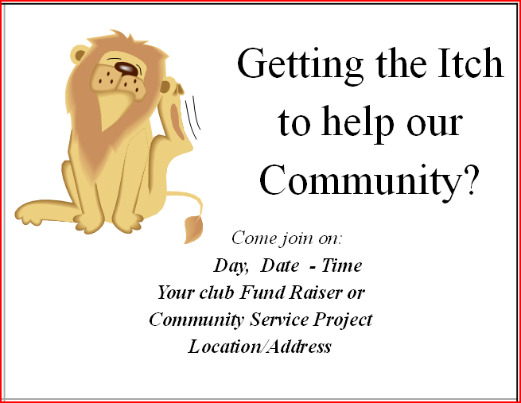
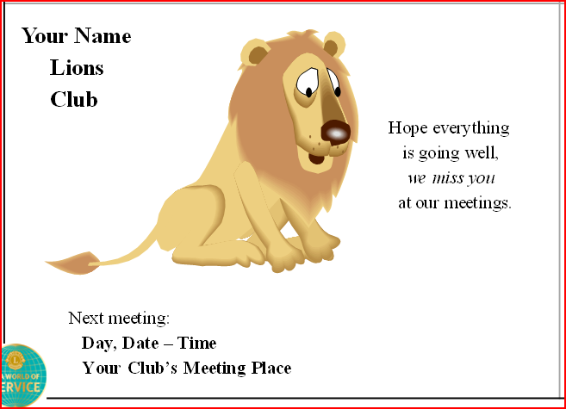
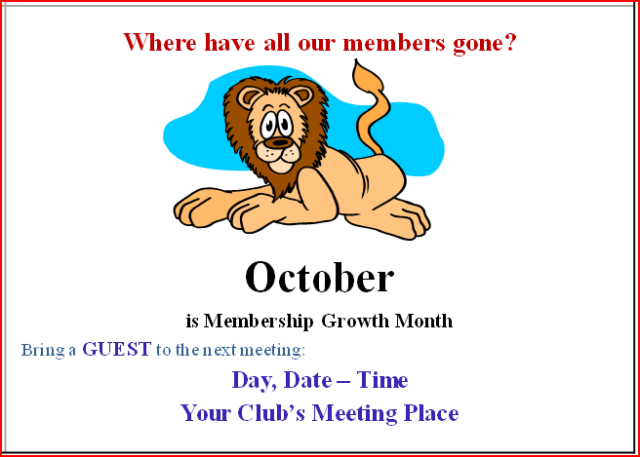
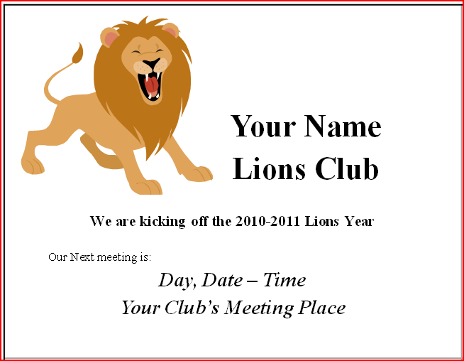
Maybe the personal touch?
A simple Postcard?

Slide 21


Slide 22
Does your club have another problem?

Slide 23
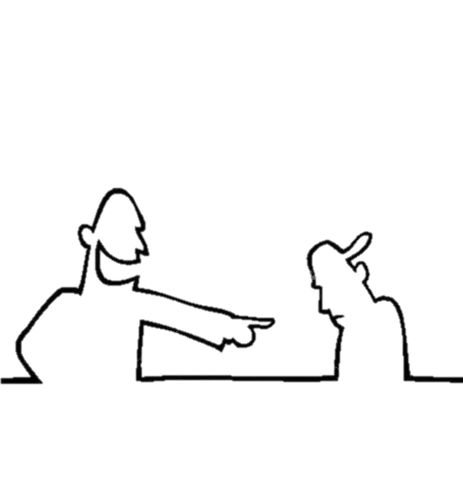


You remember that BULLY that was on our Playground?
They may now in our LIONS CLUBS.
We tried that before!

Slide 24

We can no longer just sit by and allow one member to dominate and destroy OUR clubs. We must stand up and address this issue.

Slide 25
RELEVANCY is a key to getting and keeping members.
How do you know your club is relevant to both the community and our members?

Slide 26
Ideas……..
    “Community
    Needs
    Assessment”

Slide 27

Introduce the Needs Assessment to the Club
Appoint a Committee
Develop a Questionnaire and Cover Letter
Decide Who to Contact in the Community

Slide 28
Survey Community Contacts
Analyze Survey Results
Share the Results
Match the Results with the Club’s Programs
Make changes if Necessary
www.lionsclubs.org Search for “MK9A EN”

Slide 29
The Club Excellence Process
Step 1: Why Are We Here?
Step 2: What Makes an Excellent Club
Step 3: How Can We Determine Our Needs?
Step 4: What Can We Do Next?
Notes:
The first part of any CEP Workshop is to welcome the participants.

Slide 30

Help is just a click away www.lionsclubs.org

Slide 31
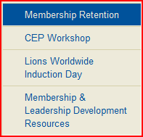
MEMBERSHIP RETENTION

Slide 32
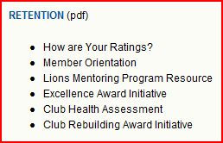

Slide 33
PUTTING ALL THE PIECES TOGETHER

Slide 34
the Answer
There is no one answer. There are many reasons why we loose Lions and equally as many answers on how our Lions Clubs can work to keep our Lions.
But one thing is true, it is every Lions’ responsibility to insure that our Clubs welcome new Lions, make everyone feel important.

Slide 35


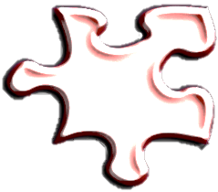

Bully
Ratings
You
Needs
Care
Relev
ance
Involve
ROAR
You are the KEY to solving the PUZZLE

Slide 36
Will you commit to
Keeping one Lions from Leaving?
  YES

Slide 37
DG Dick Silveira
dickie64@comcast.net
Barbara Toosley, PDG
LionBarb@comcast.net
Presentation available at:
www.indianalions.org
www.lions25a.org

