Slide 1
District 1-A Region and Zone Chair Overview of Roles and Responsibilities
Every Lion Counts

Slide 2
District Governor Ernie Lapid 2016-2017 Goals and Action Plan

Slide 3
District Governor Ernie Lapid Leadership Development Goals for 2016-2017
Identify, develop and encourage opportunities for present and future Lions leaders
Communicate with Vice District Governors, Region Chairs, Zone Chairs and inform them of the leadership opportunities.
Make use of the new Certified Guiding Lions in the district.
Assign Certified Guiding Lions to new Charter Clubs and to struggling clubs.
Challenge all Region Chairs and Zone Chairs to start a new club in the Regions and Zones.
Establish better communication and cooperation to achieve better attendance in Region meetings.

Slide 4
DGE Lion Ralph Zarada Membership Goals for 2016-2017
District goals should be developed for new club development.
Promote formation of a new club and a Leo club.
Encourage recruitment of 25 members per quarter or 100 new members by June 2017.
Reduce the 5-year average dropped members by 20% from 238 to 190 members.
Encourage clubs to participate in Centennial Service Challenge.
Promote the Centennial Membership Awards to Lions and Lions Clubs.
Encourage all clubs to participate in the Chicago Centennial Celebration in 2017.

Slide 5
Governor’s Introduction Protocol
It’s all about respect
At this point in time your relationship with the Governor is insignificant
Present the Governor’s biography with dignity and credibility
Read the biography verbatim, do not edit or paraphrase
When the Governor is introduced, the audience must rise and applaud

Slide 6
Cabinet Meetings Region and Zone Chairs are members of the District Cabinet
Attendance at all Cabinet meetings is required
Business attire is essential
In this role, you are part of District management and will be making management decisions
Important:
If you don’t understand, ask a question
It is ok to say no

Slide 7
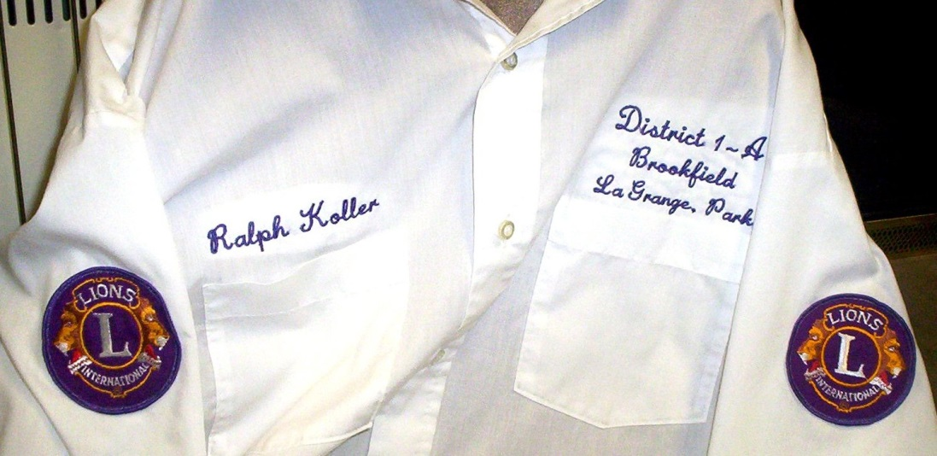
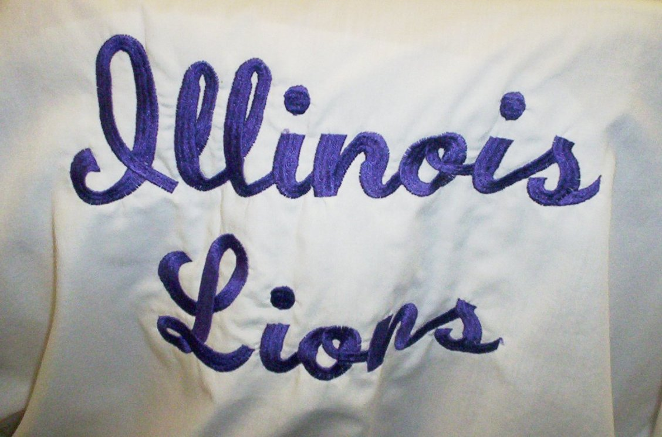
Convention attire The white shirt
To project a uniform appearance on the dais when District business is being conducted, all Region and Zone Chairs are required to wear the uniform shirt.
Contact Ralph Koller to have the shirt embroidered: 708 485 5475

Slide 8
Zone Chair

Slide 9
Zone Chair What is a Zone Chair?
You are the link between the clubs in your zone and the district team. You motivate and counsel clubs as well as communicate with the clubs to encourage them to support district programs and activities.
You wear three hats:
Motivator – Recognize club success
Counselor – Provide coaching and guidance
Communicator – Inform clubs of District information/activities and report club activities to District Governor.

Slide 10
Communications Receiving Information
Monthly Membership & PU-101 Reporting
Newsletters
Events and Meeting Notifications
Notification of planned Governor’s visit
Problems and / or Concerns

Slide 11
Communications Club Reporting
The Monthly Membership Report (MMR) is used by every Lions club to report monthly information regarding membership changes.
The report is submitted to Lion Clubs International either online through the web monthly membership reporting site (WMMR) on the association’s Web site, by mail or fax. A password is required to use the WMMR site. Questions can be directed to wmmr@lionsclubs.org.
The electronic version of the Monthly Membership Report (WMMR) must be filed by 12:00 a.m. Central Standard Time, by the last day of the current month.
The paper report has three identical sheets; the first one is mailed to International Headquarters, the second to the district designee, and the third is kept in the club’s own file.
The paper version of the Monthly Membership Report must be received at Lion Clubs International by the 20th of the current month.

Slide 12
Communications Club Reporting
Club Secretaries MUST submit monthly membership reports to
Lions Clubs international
And keep one copy for the Clubs Files
Reports must be filed monthly even if there are NO Changes from the previous month!

Slide 13
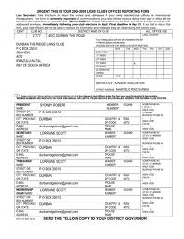
Communications New Club Officer Reporting
PU-101 forms are due by May 15th

Slide 14
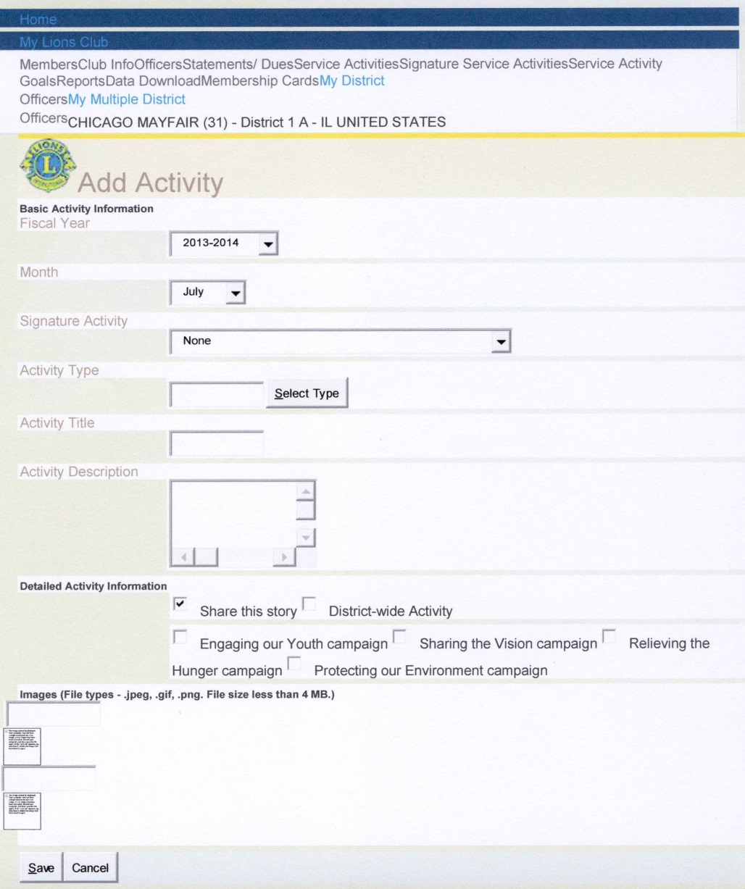
Communications Annual Activity Report
The annual activity reports have a direct impact on the funding Lions Clubs International receive from benefactors such as Bill and Melinda Gates.
Measles Initiative

Slide 15
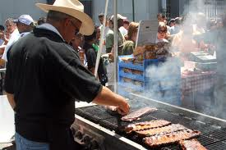
Zone Chair responsibilities The Rule of Three
Zone Chairs are required to make at least three visits to the Clubs in their zone throughout the year
Some suggestions include:
Delivering the District directory
Attending the Governor’s Official Club visit
Participating in a Club activity or service project
Note: If you’re unsure of what to wear, just ask

Slide 16
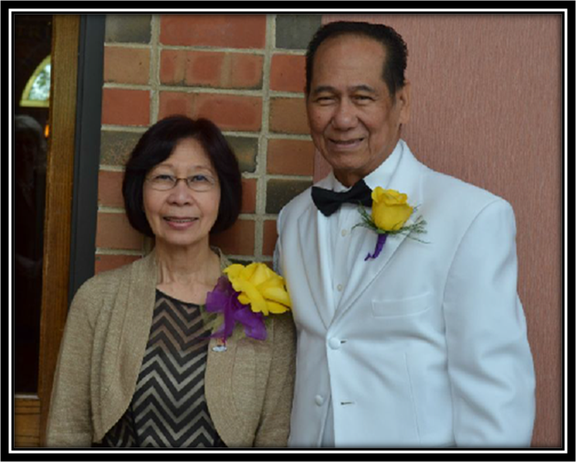
Zone Chair responsibilities Governor’s Official Club Visit
Zone and Region Chairs should both be in attendance and help with adherence to proper etiquette
Business attire is required
The Governor is the entire program (no Club business)
Governor’s Invitation should be in writing
Head table seating protocol should be observed
Introduce the Governor
Governor and raffles = NO
What does the Club want the Governor to do?
Address the group
Install officers
Induct new members
Present awards
Anything else

Slide 17
Zone Chair responsibilities Governor’s Official Club Visit
The Governor should be properly introduced
After the Governor is introduced, the audience should stand and applaud
A donation should be made to the Governor’s charities

Slide 18
Region Chairs

Slide 19
Region Chair Responsibilities The Team Builders
Verify that every club has their District 1A Directory by August 31st
Resolve issues with clubs who have over due debt
Support your Zone Chair by attending Governor’s Official Club Visits

Slide 20
Region Chair Responsibilities Region Meetings
Hold a minimum of three Region meetings per year
Region meetings are the perfect opportunity for:
Building friendships
Exchanging ideas
Engaging in moderate bragging
Ideas for guest speakers:
District Governor/Vice District Governors
Informational Speakers
New Members
GMT/GLT Coordinators
Motivational Speakers
Other Region/Activity Chairs

Slide 21
Region Chair Responsibilities Region Meetings
Publicize your Region Meetings:
District 1A Website, Lion Dawn Grogan is the webmaster
District 1A Newsletter
MD1 (State) Newsletter
District 1A Lions View magazine

Slide 22
Nurturing Leaders

Slide 23
Nurturing Leaders Leadership Initiative Program
Sponsored by the GLT and led by instructors Lion Jan Barber and Lion Frank Kirar, the LIP Program is helping to develop the leaders of District 1A.
The LIP program has an impressive list of graduates who are active in the District.

Slide 24
Information Resources

Slide 25
Information Resources Global Membership Team
Provide District Lions with the tools and knowledge to attain District Membership Goals.
Closely interact with Region Chairs, and Zone Chairs sharing new Membership tools and information.
Promote Club participation in the CEP program.
Provide District Lions Clubs with Facilitators to effectively present the CEP program.
GMT Coordinator: Lion Harold Burkett, PDG

Slide 26
Information Resources Global Leadership Team
Provide District Lions with the tools and knowledge to attain District & Personal Goals.
Closely interact with Region Chairs, and Zone Chairs sharing new Leadership tools and information.
Provide orientation for District Guiding Lions.
Provide District Lions the opportunity to reach outside their club and team build with other District Lions through the Leadership Initiative Program (LIP).
GLT Coordinator: Lion Janice Wiggins

